Slide 1
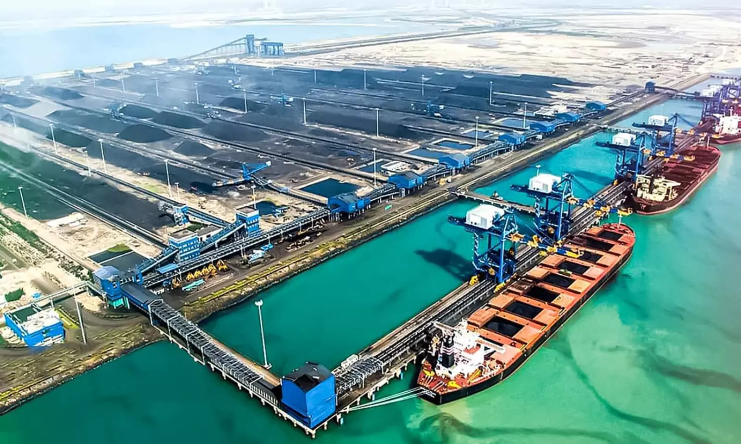
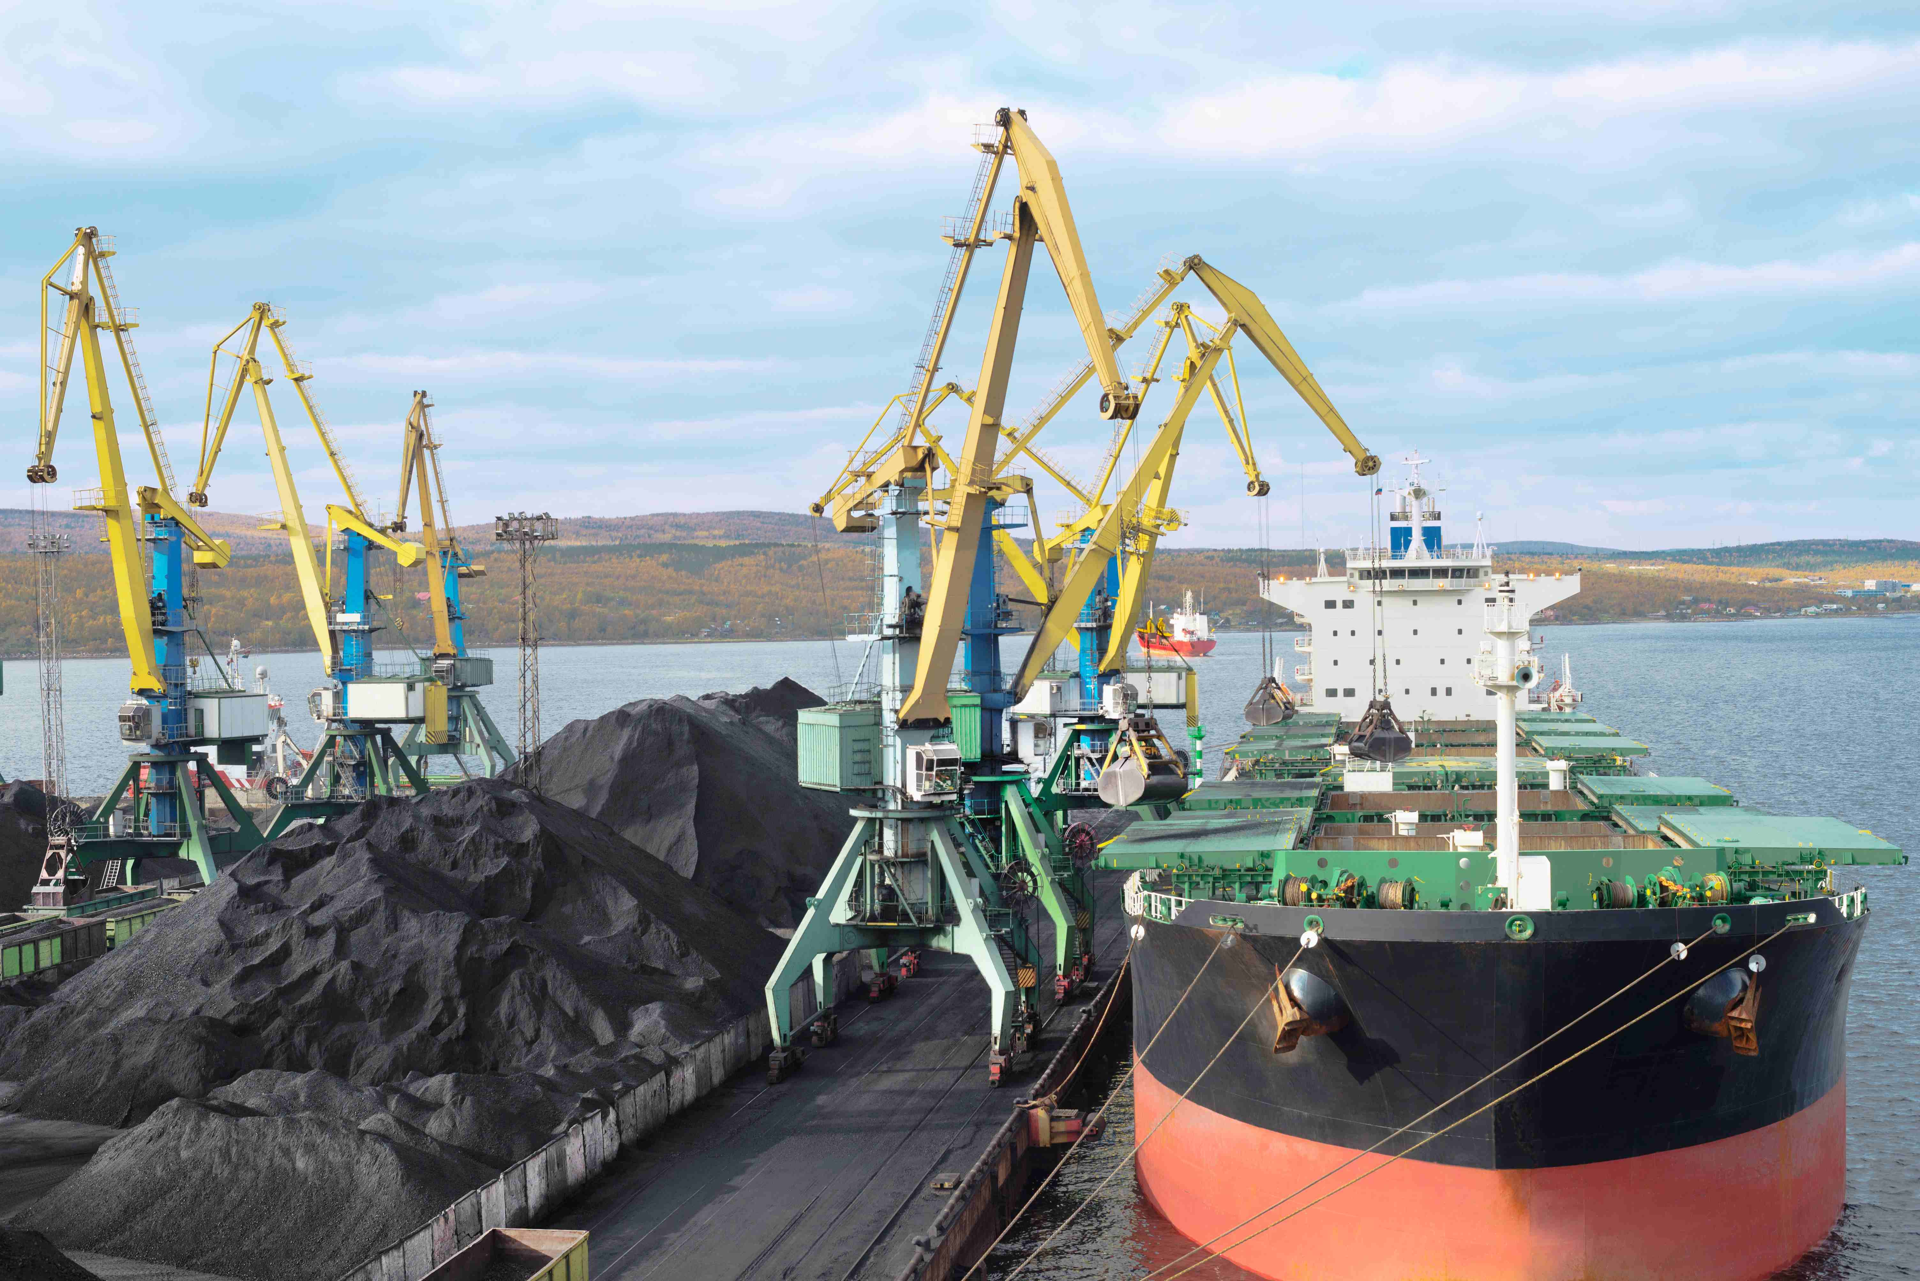
Magnifico Minerals Private Limited -under CIRP
CIN: U51909DL2011PTC228884
CP(IB) No. 230/2024
Engaged in the business of buying, selling, marketing, supplying, importing, exporting, trading minerals like coal, coke, fly ash, iron ore, bauxite, magnetize, copper, brass, zinc, metallic ores and metals like iron, aluminium, silver, copper or any scrap or by products of the metals and metal scraps and to act as sole selling agents, commission agents, sales organisers, distributors, etc.

Slide 2
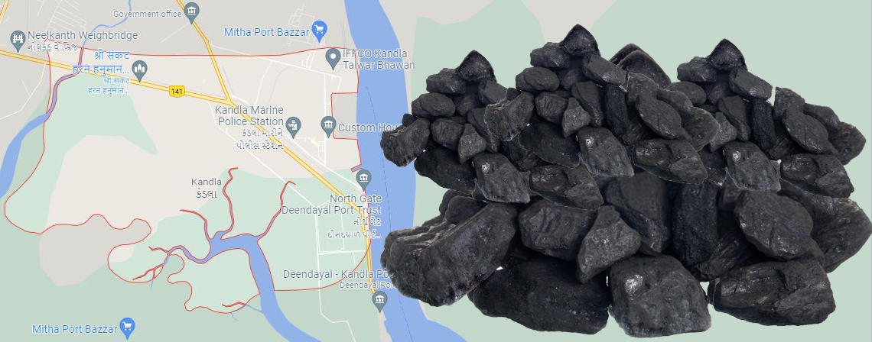
Registered Address:
Plot No. 25, DSIIDC Shed, Scheme-II, Basement, Okhla Industrial Area, Phase II, Okhla Industrial Estate, South Delhi, New Delhi, Delhi, India, 110020
Books of Accounts maintained at:
Plot No 25, DSIDC SCHEME II Okhla Industrial Area, Phase-II, New Delhi, Delhi, India, 110020

Slide 3
Projected Growth in the Coal Sector
Year | Coking Coal |  | Non-Coking Coal |  | Total Coal
 | Quantity | Value Rs. | Quantity | Value Rs. | Quantity | Value Rs.
2013-14 | 36.872 | 348318.65 | 129.985 | 574973.16 | 166.857 | 923291.81
2014-15 | 43.715 | 337655.59 | 168.388 | 707585.71 | 212.103 | 1045241.30
2015-16 | 44.561 | 282519.09 | 159.388 | 577818.53 | 203.949 | 860337.62
2016-17 | 41.644 | 412300.61 | 149.365 | 590772.69 | 191.009 | 1003073.30
2017-18 | 47.003 | 595226.36 | 161.245 | 789543.41 | 208.249 | 1384769.77
2018-19 | 51.838 | 720497.64 | 183.510 | 988707.26 | 235.348 | 1709204.90
2019-20 | 51.833 | 612668.32 | 196.704 | 914652.23 | 248.537 | 1527320.55
2020-21 | 51.198 | 453552.10 | 164.054 | 706688.44 | 215.251 | 1160240.54
2021-22 (Nov 21) | 39.780 | 580134.18 | 107.363 | 772412.34 | 147.143 | 1352546.52
2020-21 (Nov 20) | 29.736 | 267746.43 | 104.817 | 430607.76 | 134.553 | 698354.19
Growth % | 33.776 | 116.67 | 2.429 | 79.38 | 9.357 | 93.68
Source: Published CCO Directory of India 2020-21

Slide 4
Business Operations/Handling
The Company operated from various ports including but not limited to following:-
Mangaluru Port, Karnataka
Kandla Port, Gujarat
Vizag/Vishakhapatnam Port, Andhra Pradesh

Slide 5
CD Details
Industry | Minerals
Total Exposure | Rs. 566.15 Cr. (Approx.)
Major Financial Creditors | Central Bank of India, State Bank of India, Bank of India, Bank Of Baroda, Union Bank of India
Outcome | CIRP initiated and EOI published for prospective Resolution Applicant
Losses to be carried forward to future years | Rs. 91.29 Cr. (Approx.)
CIRP Initiated | 07 August 2024
Paid-up Capital | Rs. 12,00,90,000/-

Slide 6
Thank You

